Slide 1



Micro Credit Defaulter Case Study
Arpita Rai
Int 33

Slide 2
Problem Statement
Many microfinance institutions (MFI), experts and donorsare supporting the idea of using mobile financial services (MFS) which they feel are more convenient and efficient, and cost saving, than the traditional high-touch model used since long for the purpose of delivering microfinance services.
Our client is in Telecom Industry. They are a fixed wireless telecommunications network provider. They have launched various products and have developed its business and organization based on the budget operator model, offering better products at Lower Prices to all value conscious customers through a strategy of disruptive innovation that focuses on the subscriber.

Slide 3
They are collaborating with an MFI to provide micro-credit on mobile balances to be paid back in 5 days. The Consumer is believed to be defaulter if he deviates from the path of paying back the loaned amount within the time duration of 5 days. For the loan amount of 5 (in Indonesian Rupiah), payback amount should be6(in Indonesian Rupiah), while, for the loan amount of 10(in Indonesian Rupiah), the payback amount should be 12(in Indonesian Rupiah).
In order to improve the selection of customers for the credit, the client wants some predictions that could help them in further investment and improvement in selection of customers.
We need to build a model which can be used to predict in terms of a probability for each loan transaction, whether the customer will be paying back the loaned amount within 5 days of insurance of loan. In this case, Label ‘1’ indicates that the loan has been payed i.e. Non- defaulter, while, Label ‘0’ indicates that the loan has not been payed i.e. defaulter.

Slide 4
Understanding the Data
In the dataset we see that the target is already available, which makes it a problem of Supervised Machine Learning.
Based on the type of target, we have decided the algorithms to be used.
Here the target is classified and we have used Classification algorithm on the dataset.
Before applying algorithms we have cleaned and pre-process the data. Then we have split the dataset into training model and testing model.
Steps we followed are:
Data collection and analysis.
Data cleaning and pre-processing
Building the model and selecting the best one.
Conclusion and saving the model

Slide 5
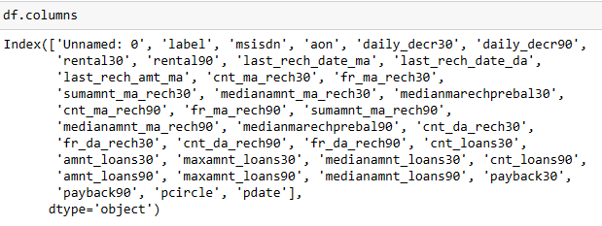
Exploratory Data Analysis
The dataset has 209593 rows and 37 columns.
There are 36 features and 1 target in the dataset.
Here, Label is our target column.
Other columns are:-

Slide 6
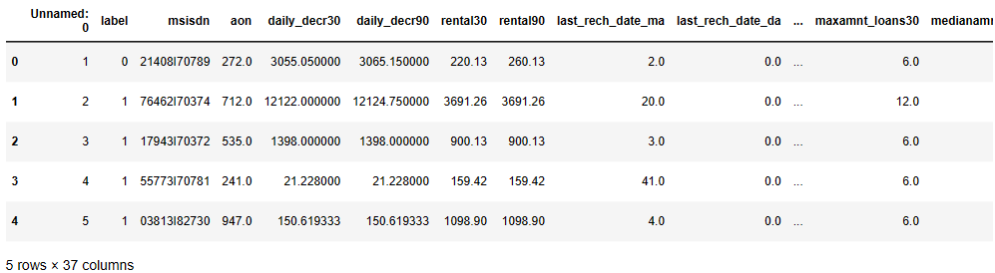
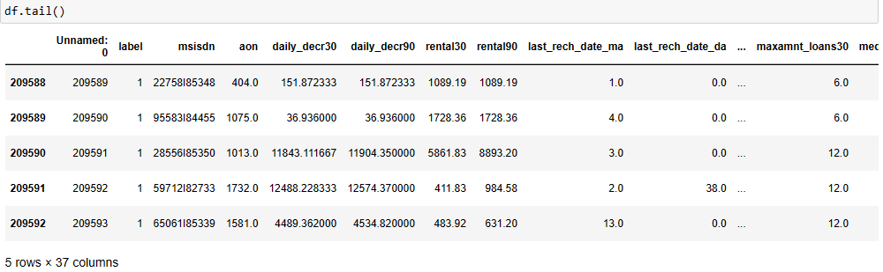
D
A
T
A
S
E
T

Slide 7
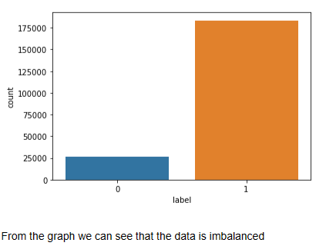
Univariate Analysis
Univariate analysis explores each variable in a data set, separately.
We have used countplot, histogram, distribution plot, kde plot, pie charts, strip plot and box plot to present the data of each columns.
This count plot shows that the data is imbalanced.
Count Plot

Slide 8
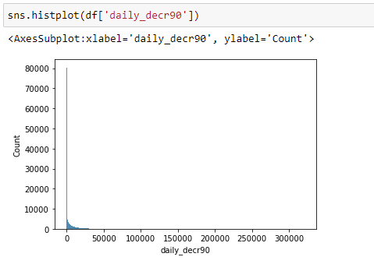
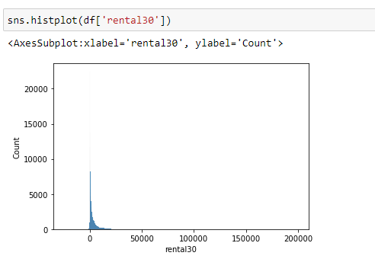
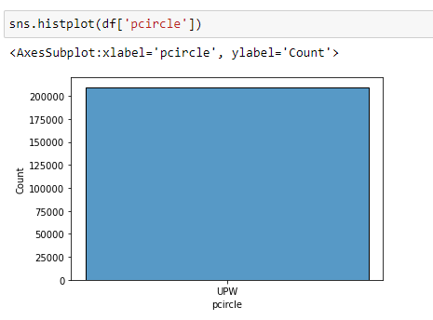
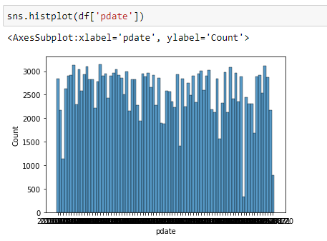
Histogram
Histogram: A histogram is a graphical representation of continuous data in a categorical format. .
Here we see that the mobile number and date has very wide range of data which does not contribute much in prediction of ‘label’.
The feature ‘pcircle’ has only one type of value which also does not contribute in ‘label’ prediction.
Hence we will drop all three.

Slide 9
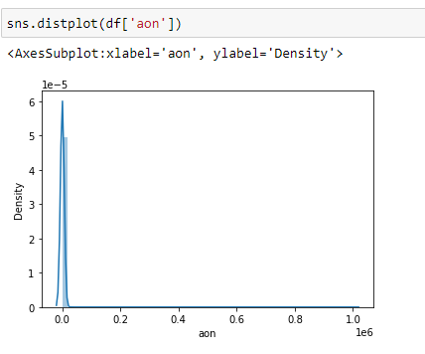
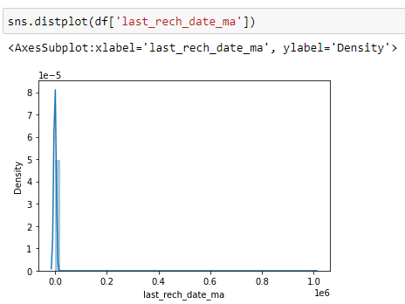
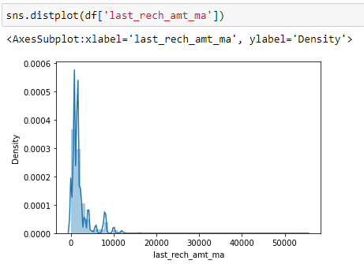
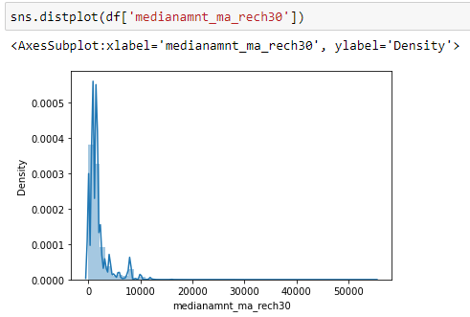
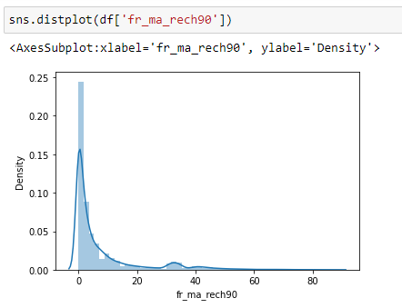
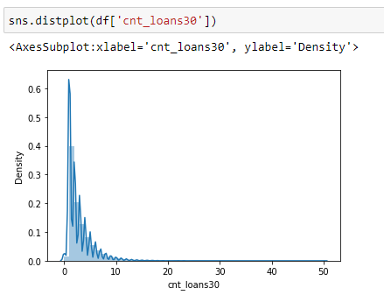
Distribution Plot

Slide 10
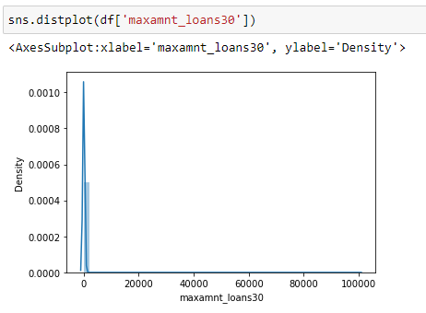
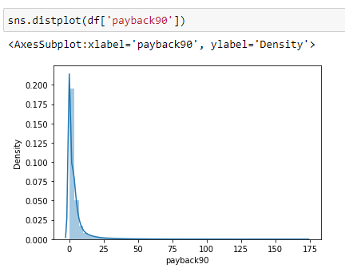
Distribution Plot: It is mostly used for univariant sets of observations and visualises them using a histogram.
Through this we get to know that there are skewness in these three columns which are ‘cnt_da_rech30’, ‘fr_da_rech90’ and ‘cnt_loans90’.

Slide 11
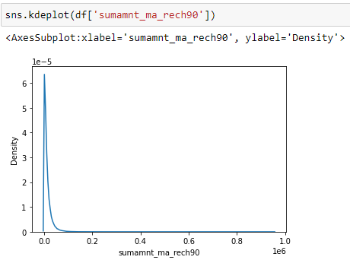
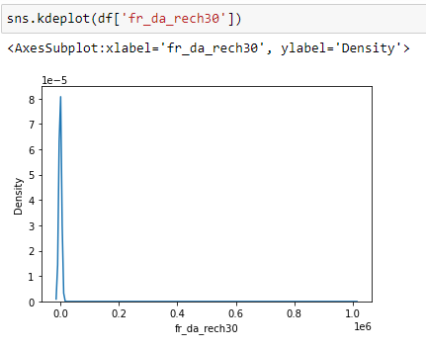
Kernel Density Estimate Plot
A Kernel Density Estimate plot is a way of showing distribution of observations in dataset. Here both the graphs are representing normal distribution.

Slide 12
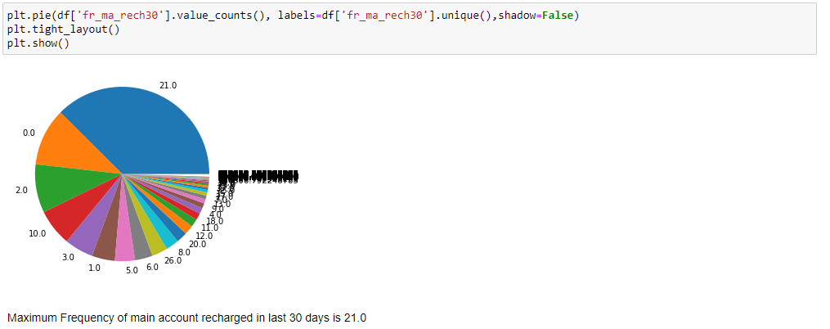
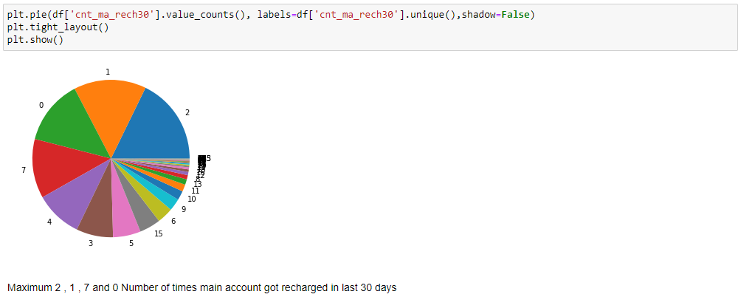
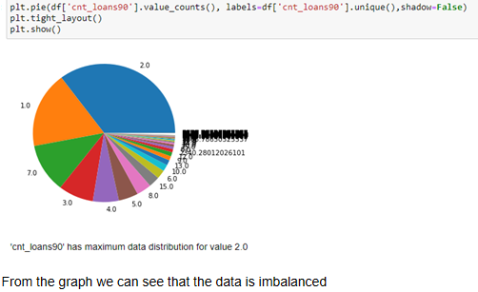
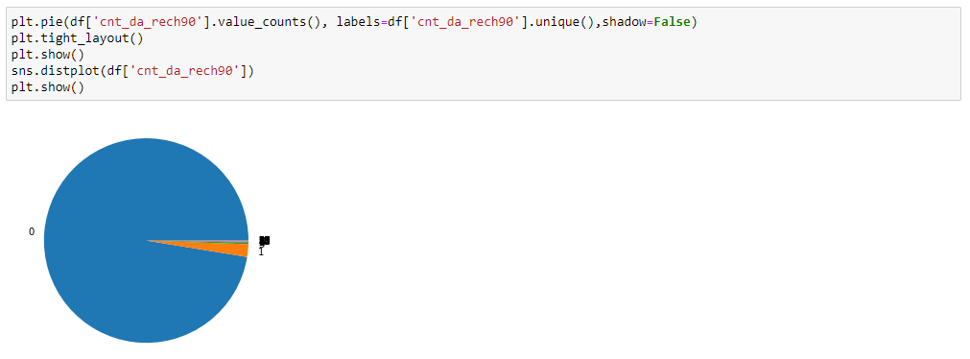
PIE CHART

Slide 13
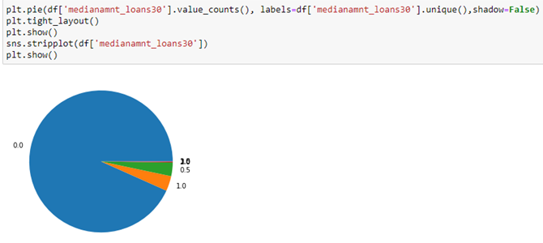
A pie chart is a circular statistical graphic, which is divided into slices to illustrate numerical proportion. In a pie chart, the arc length of each slice is proportional to the quantity it represents.
From the above pie charts we can see how data the distributed and where the data is valued maximum.

Slide 14
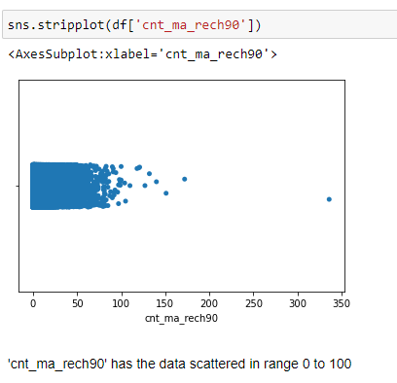
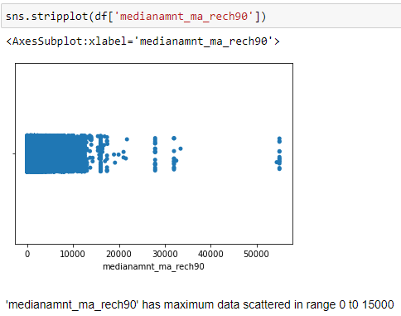
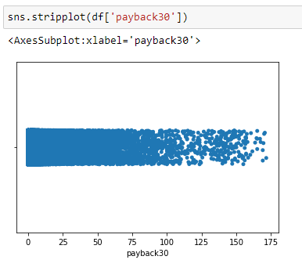
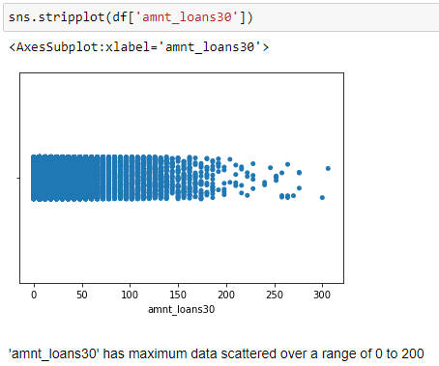
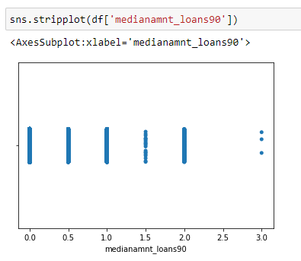
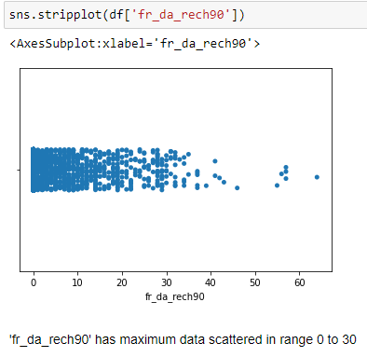
Strip Plot
It gives us the range over which the observations are distributed.

Slide 15
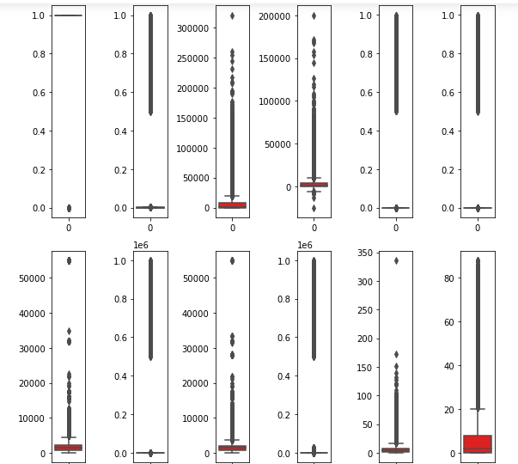
Box Plot
A single box plot can be used to illustrate multiple statistics from a vast quantity of data.
Box plots provide some insight into the symmetry and skewness of the data.
Outliers are also visible in box plots.

Slide 16
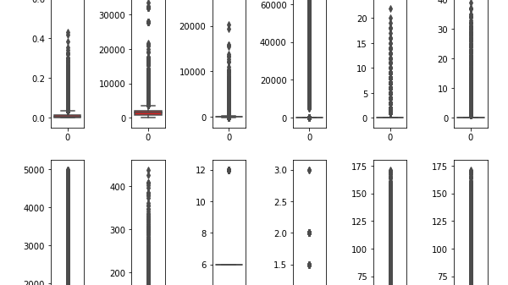
There are so many outliers in the dataset and if we remove all the outliers, we will lose almost 18% of the data and we can’t afford to lose that much of data, hence we will remove the outliers with zscore for value more than 5 and by this we will lose only 7.5% of the data which is acceptable.

Slide 17
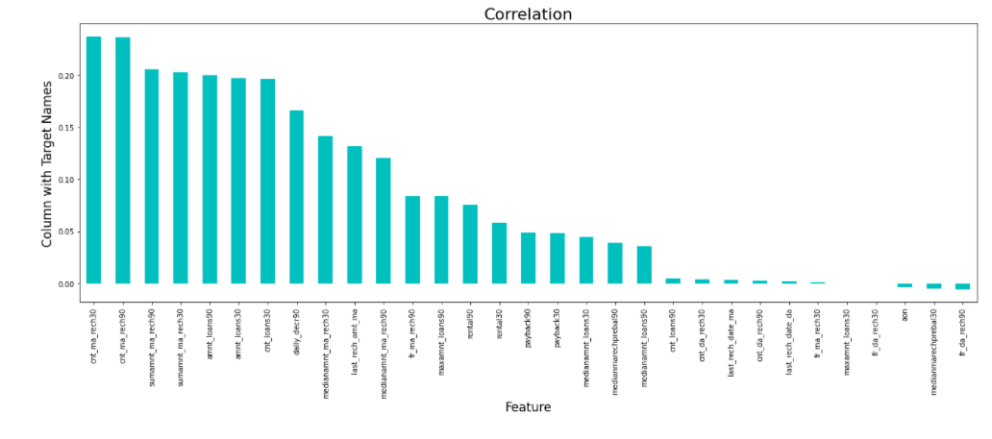
Bar Graph
While checking the correlation using Corr(), we found out that, two features have negligible correlation with the target, which we can drop to make our model more effective.
These features are : ‘maxamnt_loans30’ (maximum amount of loan taken by the user in last 30 days)
‘fr_da_rech30’ (Frequency of data account recharged in last 30 days).

Slide 18
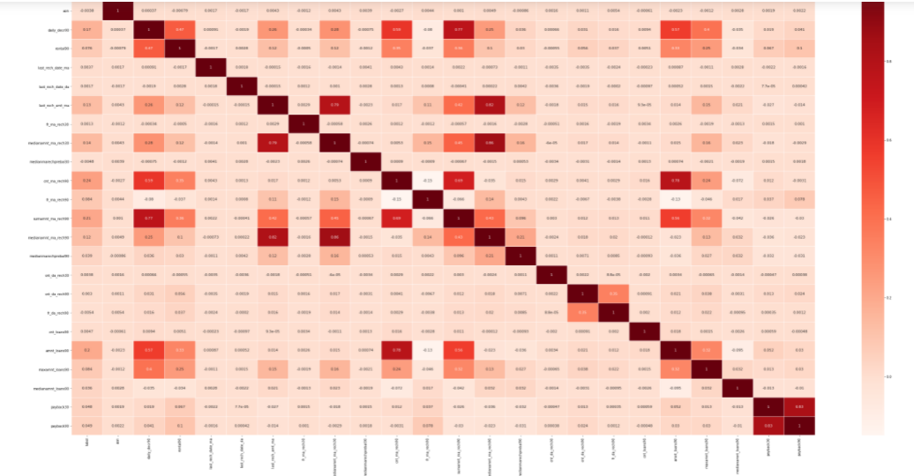
Heat Map
From the above heatmap we conclude that -
‘cnt_ma_rech90’ has the maximum positive correlation with the target.
As the value of ‘cnt_ma_rech90’ increases, there is more chances of a customer being a non-defaulter.
‘sumamnt_ma_rech90’, ‘amnt_loans90’ and ‘cnt_loans30’ have same positive correlation with the target.
Rest all the features have comparatively less correlation with the target.
‘aon’, ‘fr_da_rech90’ and ‘medianmarechprebal30’ are negatively correlated to the data at a very minimum number.

Slide 19
Data Cleaning
There are no missing values in the dataset.
There are many outliers in the dataset and we have removed the outliers using ZSCORE Method.
There were skewness in few features and we have also removed that with Yeo-Johnson method.
We have dropped few columns to make the more accurate.

Slide 20
Data Pre-processing
We have separated the features and target into x and y, respectively.
We have standardize the scale of features for better results.
Split the dataset into Training model and Testing model.
Balancing the class by Over Sampling.
Building the model

Slide 21
Model Building
.
Since the dataset is quite large in size and it’s a classification problem, we have applied 5 algorithms:-
Logistic Regression
Stochastic Gradient Descent Classifier
Decision Tree Classifier
Gradient Boosting Classifier
Random Forest Classifier

Slide 22
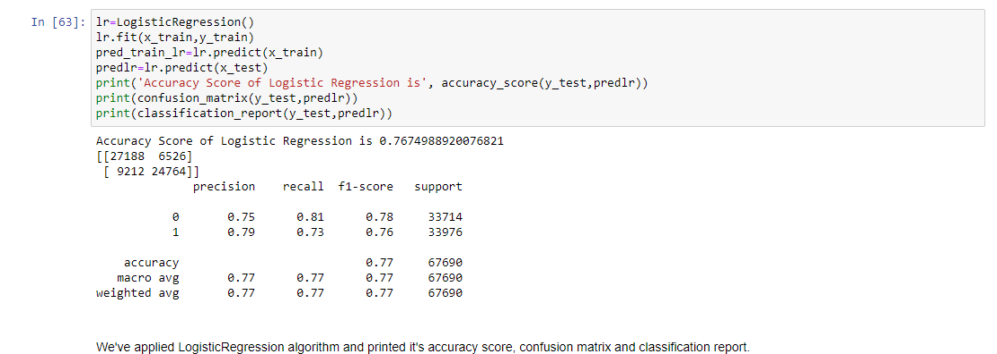
Logistic Regression
The accuracy of Logistic Regression is 0.76 and the performance of the model based on precision and recall is also okay.

Slide 23
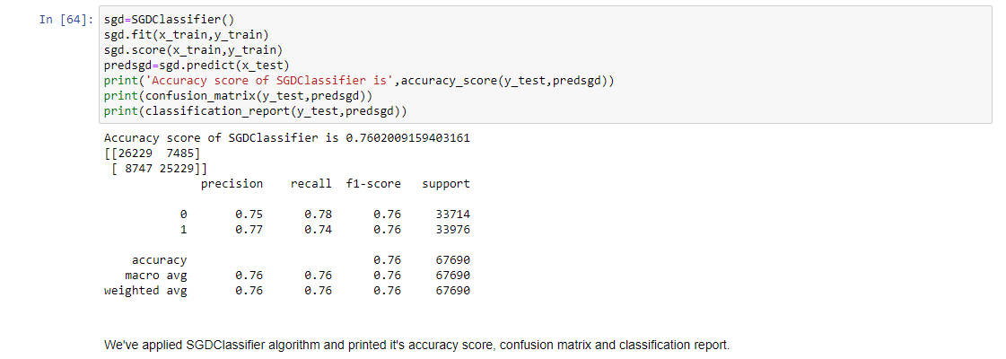
Stochastic Gradient Descent Classifier
The accuracy of Stochastic Gradient Descent is 0.76 and the performance of the model based on precision and recall is okay.

Slide 24
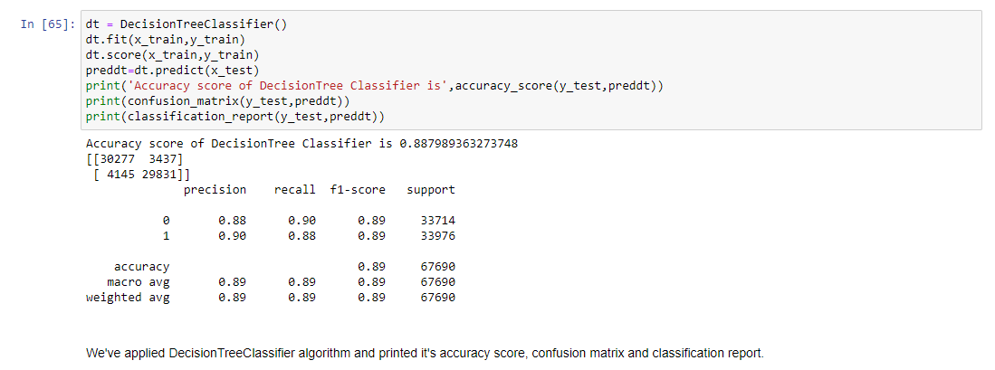
Decision Tree Classifier
The accuracy of Decision Tree Classifier is 0.88 and the performance of the model based on precision and recall is better than all the previous algorithms used.

Slide 25
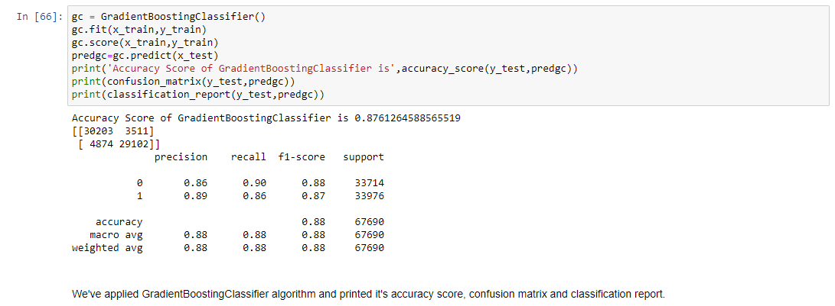
Gradient Boosting Classifier
The accuracy of Gradient Boosting Classifier is 0.87 which is quite appreciable. The confusion matrix for this algorithm is also in good shape. On the basis of F1 Score, Precision and Recall we can say that model performs quite well.

Slide 26
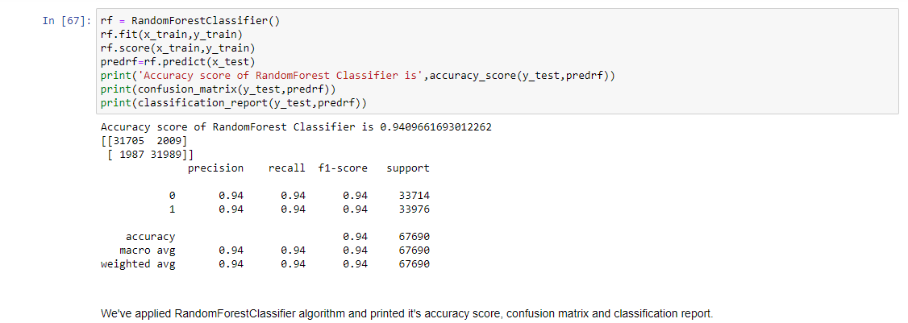
Random Forest Classifier
The accuracy of Random Forest Classifier is 0.94 which is quite appreciable. The confusion matrix for this algorithm is also in very good shape. On the basis of F1 Score, Precision and Recall we can say that model has acceptably high performance.

Slide 27
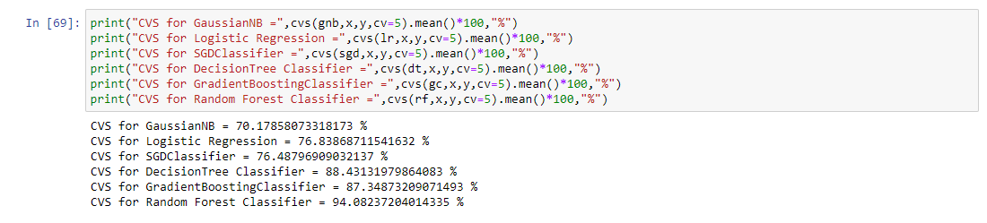
Cross Validation Score
Since the accuracy and model performance of Random Forest Classifier is highest; and the difference between accuracy and cross validation score for this algorithm is lowest, Hence we chose Random Forest Classifier for Hyper Parameter Tuning.

Slide 28
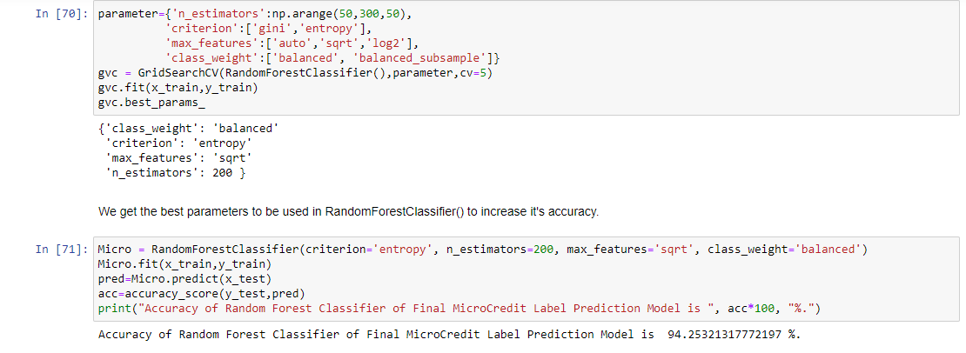
Hyper Parameter Tuning
First we pass few parameters in GridSearchCV to get the best fit parameter for our model.
Now we use these parameteric values in our finalized model. The accuracy , precision, recall and F1 Score has been increased after this operation.

Slide 29
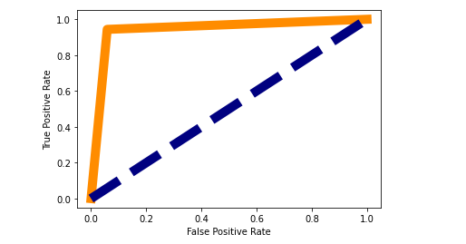
Area Under the Curve – Receiver Operating Characteristic Curve
AUC assesses how well predictions are ranked. Regardless of the classification threshold used, AUC also assesses the accuracy of the model's predictions.
A ROC curve is a graph that shows how well a classification model performs across all categorization levels.
By lowering the classification threshold, the model is able to classify more items as positive, resulting in a higher number of False Positives and True Positives.

Slide 30
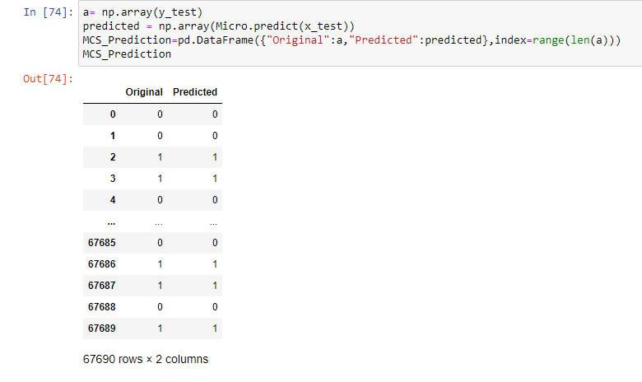
Conclusion
We conclude that our finalized hyper parameter tuned Random Forest Classifier Model is working really well. The values it has predicted are same as the original values.
Now we will save this model so that we can use this model for future prediction purpose.

Slide 31
Thank You

